Slide 1


Slide 2

Questions about first class?

Slide 3
Information about commits
- Change the name of your files to avoid overwrite them
- Try to be organize with your code (use comment symbols # to split exercises areas)
- Highlight the number of the exercise referred in the piece of code
- Put your names in the beginning of the files
- Write messages about related to the changes applied in the code in the commit messages

Slide 4
Class 1 - Review
Function to print data in the console: -print()
Function to receive data from the user: -input()
It is possible to store values in variables
We could use + * to concatenate strings
Most used variables in basic level are types: strings, int and float.
It is not possible to concatenate strings and numbers.
It is possible to make + - * / // operations in python.
It is possible to print in several ways (one argument, multiple arguments, one line, multiple lines, one space, multiple spaces, one letter, multiple letters, finite sequence of letters).
Create your own online repository is not that complicated.
Basic git commands add, commit –m, push.
It is possible to use several IDEs to program in python.

Slide 5
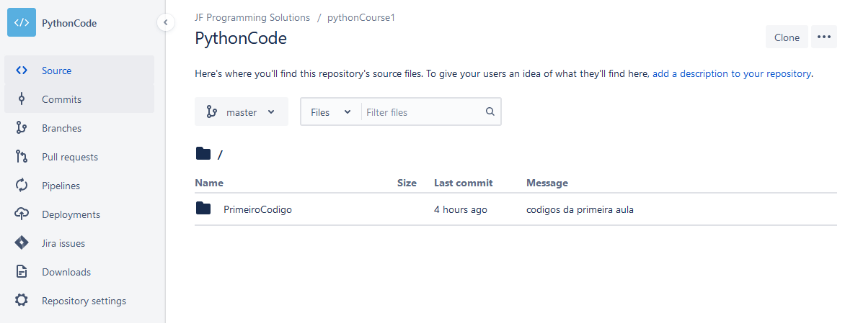

Slide 6
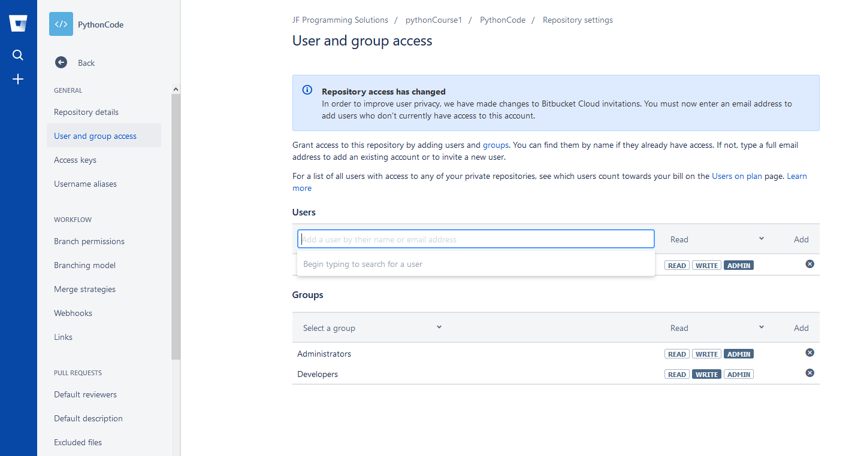
jcova1@iscte-iul.pt

Slide 7
1. Try the following mathematical calculations and guess what is happening: ((3 / 2)), ((3 // 2)), ((3 % 2)), ((3**2)).
Suggestion: check the Python library reference at https://docs.python.org/3/library/
stdtypes.html#numeric-types-int-float-complex.
2. Calculate the average of the following sequences of numbers: (2, 4), (4, 8, 9), (12,14/6, 15)
3. The volume of a sphere is given by (4/3 * pi * rˆ3). Calculate the volume of a sphere
of radius 5. Suggestion: create a variable named “pi” with the value of 3.1415.
4. Use the modulo operator (%) to check which of the following numbers is even or
odd: (1, 5, 20, 60/7).
Suggestion: the remainder of (x/2) is always zero when (x) is even.

Slide 8
Making decisions and perform tasks repeatedly

Slide 9
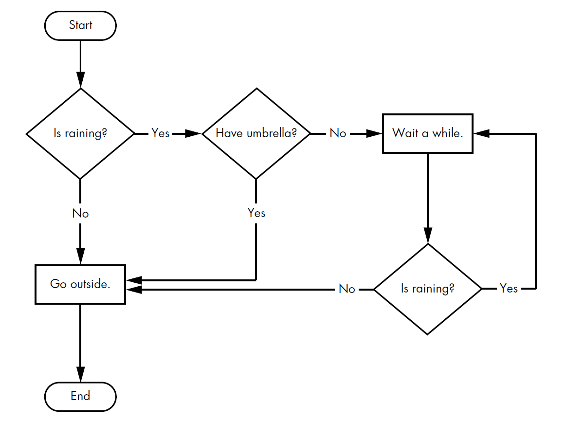
IF
IF
While
IF

Slide 10
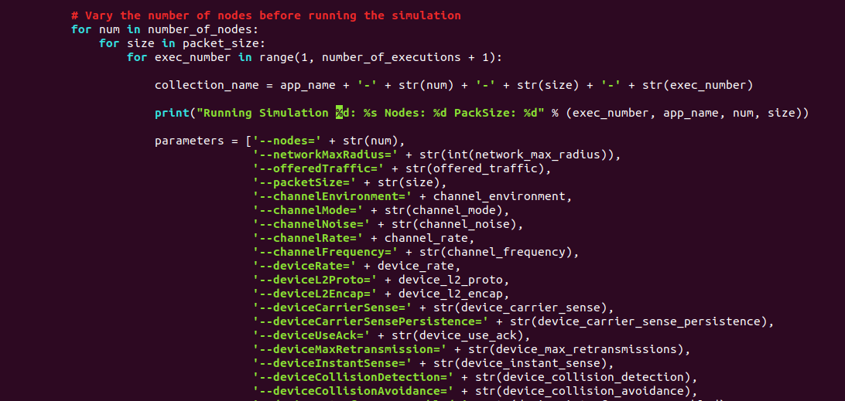
Indentation

Slide 11
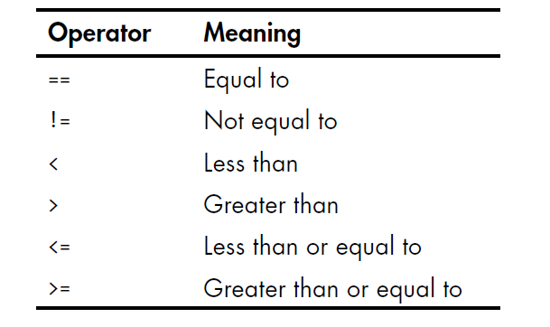
Comparison operators

Slide 12
https://docs.python.org/3/library/functions.html#ord
Comparisons using print
print(4==5)
print(6>7)
print(15<100)
print('hello' == 'hello')
print('hello' == 'Hello')
print('dog' != 'cat')
print( True == True)
print(True != False)
print( 42 == 42.0)
print( 42 == '42’)
print('apple' == 'Apple’)
print('apple' > 'Apple’)
print('A unicode is', ord(‘A’) ,’ ,a unicode is’ , ord(‘a’)) #unicode

Slide 13
https://docs.python.org/3/library/functions.html#ord
Comparisons using print
print(4==5)
print(6>7)
print(15<100)
print('hello' == 'hello')
print('hello' == 'Hello')
print('dog' != 'cat')
print( True == True)
print(True != False)
print( 42 == 42.0)
print( 42 == '42’)
print('apple' == 'Apple’)
print('apple' > 'Apple’)
print('A unicode is', ord(‘A’) ,’ ,a unicode is’ , ord(‘a’)) #unicode

Slide 14
What is the minimum age to drive in Portugal?
minimum_age =
age =
if age > minimum_age:
print(“Congrats, you can get your license”)
else
print(“Please, come back in {0} years” .format(minimum_age - age))

Slide 15
Getting Access
name =
password =
if name == ‘Josi’:
print('Hello Josi')
if password == 'swordfish':
print('Access granted.')
else:
print('Wrong password.')

Slide 16
What is the minimum age to drive in Portugal?
And the maximum age ?
minimum_age =
user_age =
if age < minimum_age:
print("Please, come back in {0} years" .format(minimum_age – user_age))
elif age == 150 :
print("Probably, you can not drive anymore. Please, make an appointment with your doctor.")
else :
print("Congrats, you can get your license.")

Slide 17
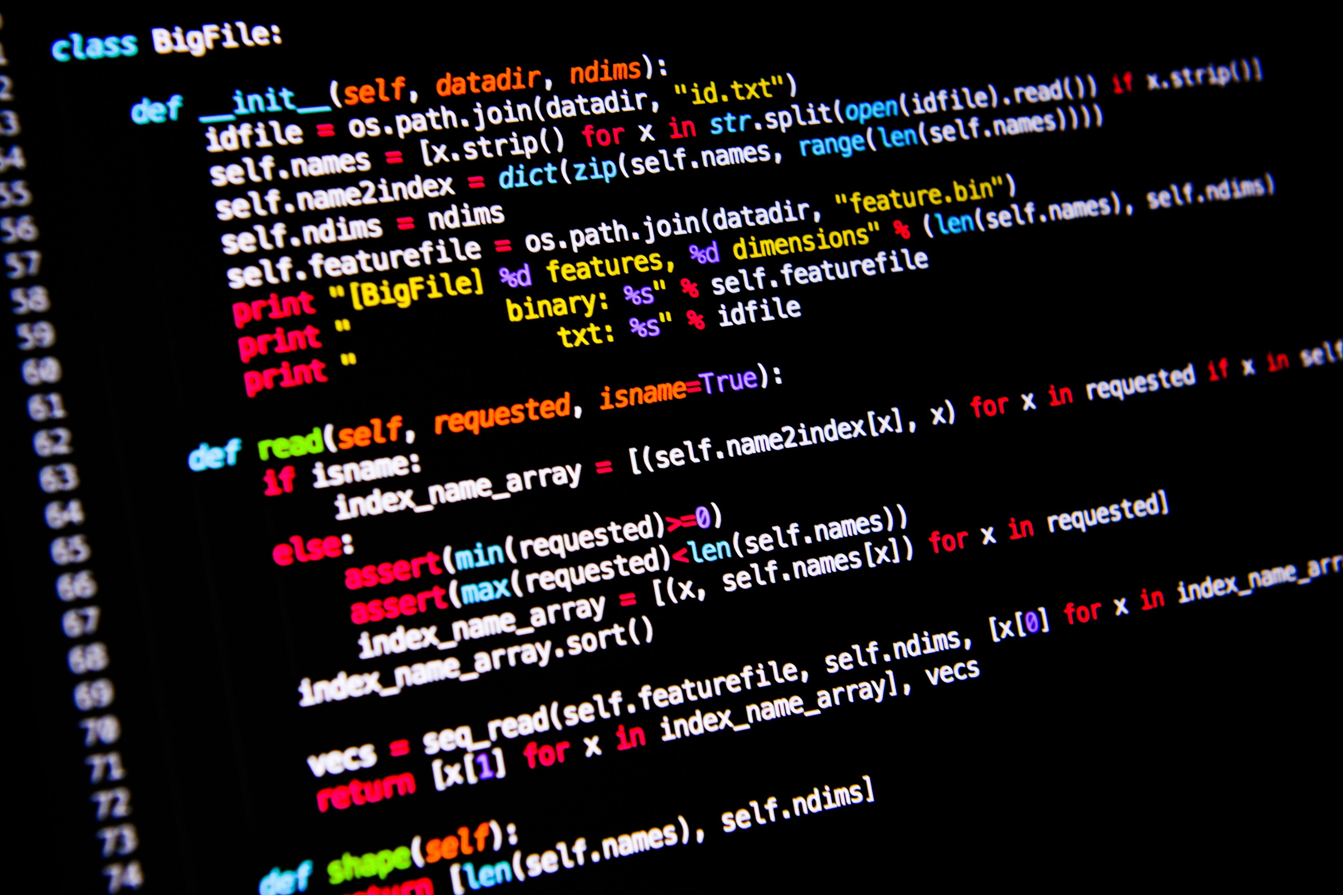
<WELCOME >
<Exercise - 1>

Slide 18
Exercise 1
Write a code that guess the number stored in a variable
Input: guess_number
Expected Output:
Please, guess higher # if the guess_number is smaller than answer
Please, guess lower # if the guess_number is higher than answer
Congrats, you found the answer!!

Slide 19
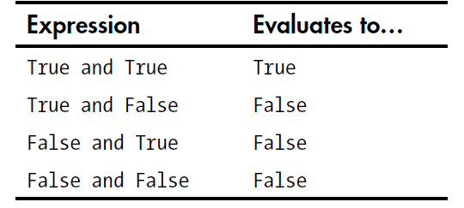
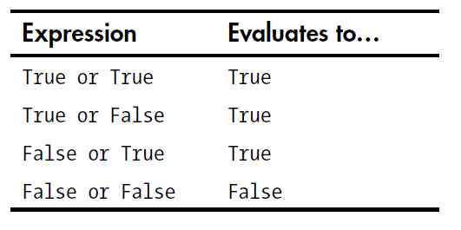
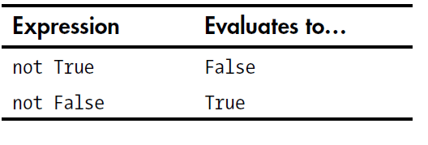
Comparison operators
“And” Truth table
“Or” Truth table
“Not” Truth table

Slide 20
Comparisons using print
print(4 < 5) and (5 < 6)
print(4 < 5) and (9 < 6)
print(1 == 2) or (2 == 2)
Print (2 + 2 == 4 and not 2 + 2 == 5 and 2 * 2 == 2 + 2)

Slide 21
<WELCOME >
<Exercise - 2>

Slide 22
Exercise 2
Write a code to ask How old are you ? Store the age in a variable and print it
Expected input: <Your age>
Expected output <Your age>
b. Improve your code to check if you have age to retire or not
Expected input: <Your age>
Expected output: Have a good day at work # if your age is in the range of 16 – 65
You are too young to work, come back to school # if <your age> smaller than 16
You have worked enough, Let’s Travel now # if <your age> greater than 65

Slide 23
Code using conditionals
a = 3
b = 2
if a==5 and b>0:
print(‘a is 5 and',b,'is greater than zero.’)
else:
print('a is not 5 or',b,'is not greater than zero.')

Slide 24
Be careful using conditionals
day = “Saturday”
temperature = 30
raining = False
If day ==“Saturday” and temperature > 20 and not raining :
print(“Go out ”)
else:
print (“Better finishing python programming exercises”)

Slide 25
Repeated Steps
n = 5
Output:
5
4
3
2
1
Boom!!
0
Program:
n = 5
while n > 0 :
print(n)
n = n – 1
print(‘Boom!!')
print(n)
No
n > 0 ?
Yes
print(n)
n = n -1
Loops (repeated steps) have iteration variables that change each time through a loop. Often these iteration variables go through a sequence of numbers.
print(Boom!!')

Slide 26
An Infinite Loop
n = 5
No
n > 0 ?
Yes
n = 5
while n > 0 :
print(‘Time')
print(‘ticking ')
print(‘Stopped')
print(‘Time')
print(‘Ticking')
What is wrong with this loop?
print(‘Stopped!')

Slide 27
Another Loop
n = 5
No
n > 0 ?
Yes
n = 0
while n > 0 :
print(‘Time')
print(‘ticking ')
print(‘Stopped')
print(‘Time')
print(‘Ticking')
What is wrong with this loop?
print(‘Stopped!')

Slide 28
Breaking Out of a Loop
The break statement ends the current loop and jumps to the statement immediately following the loop
It is like a loop test that can happen anywhere in the body of the loop
while True:
line = input('> ')
if line == 'done' :
break
print(line)
print('Done!')
> hello there
hello there
> finished
finished
> done
Done!

Slide 29
Breaking Out of a Loop
The break statement ends the current loop and jumps to the statement immediately following the loop
It is like a loop test that can happen anywhere in the body of the loop
while True:
line = input('> ')
if line == 'done' :
break
print(line)
print('Done!')
> hello there
hello there
> finished
finished
> done
Done!

Slide 30
No
True ?
Yes
while True:
line = input('> ')
if line == 'done' :
break
print(line)
print('Done!')
....
break
...
print('Done')

Slide 31
Finishing an Iteration with continue
The continue statement ends the current iteration and jumps to the top of the loop and starts the next iteration
while True:
line = input('> ')
if line[0] == '#' :
continue
if line == 'done' :
break
print(line)
print('Done!')
> hello there
hello there
> # don't print this
> print this!
print this!
> done
Done!

Slide 32
Finishing an Iteration with continue
The continue statement ends the current iteration and jumps to the top of the loop and starts the next iteration
while True:
line = input('> ')
if line[0] == '#' :
continue
if line == 'done' :
break
print(line)
print('Done!')
> hello there
hello there
> # don't print this
> print this!
print this!
> done
Done!

Slide 33
No
True ?
Yes
while True:
line = raw_input('> ')
if line[0] == '#' :
continue
if line == 'done' :
break
print(line)
print('Done!')
....
continue
...
print('Done')

Slide 34


